Slide 1
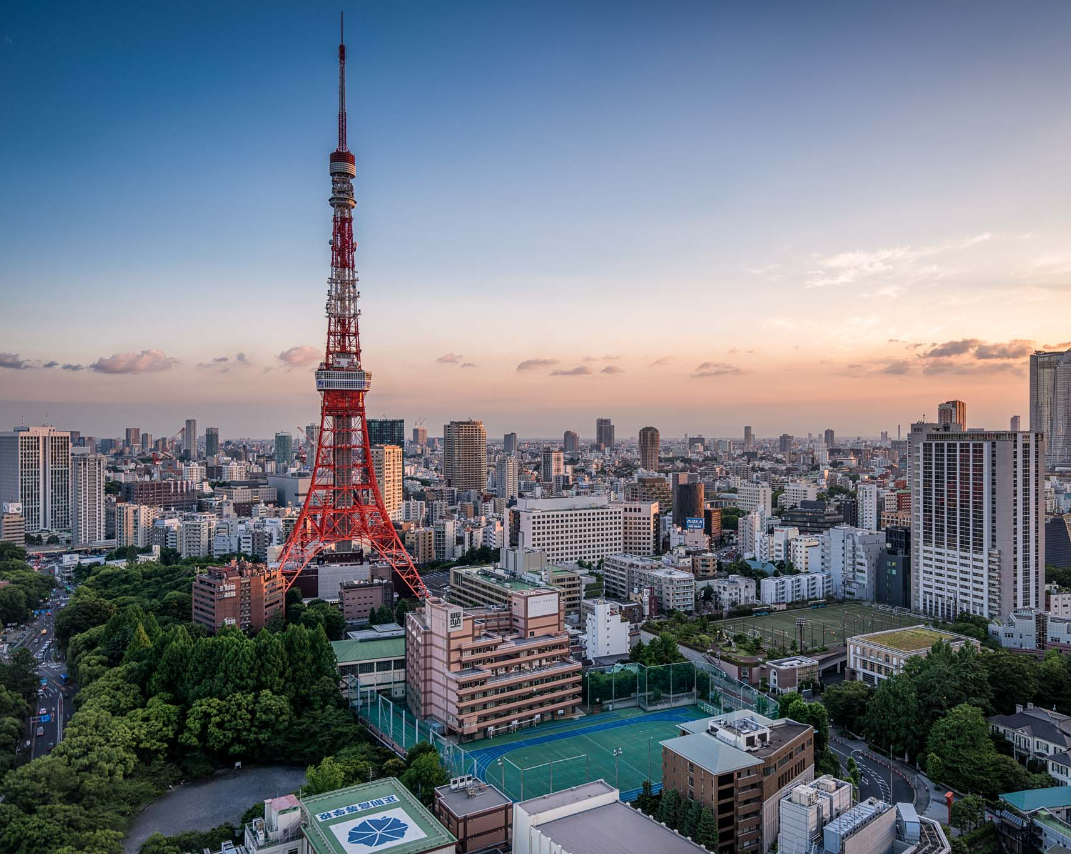
The Battle of Neighborhoods - Tokyo
IBM CAPSTONE
This Photo by Unknown author is licensed under CC BY-NC.

Slide 2
1. Introduction
Tokyo (東京, Tōkyō) is Japan's capital and the world's most populous metropolis. It is also one of Japan's 47 prefectures, consisting of 23 central city wards and multiple cities, towns and villages west of the city center. The Izu and Ogasawara Islands are also part of Tokyo.
Today, Tokyo offers a seemingly unlimited choice of shopping, entertainment, culture and dining to its visitors. The city's history can be appreciated in districts such as Asakusa and in many excellent museums, historic temples and gardens. Contrary to common perception, Tokyo also offers a number of attractive green spaces in the city center and within relatively short train rides at its outskirts.

Slide 3
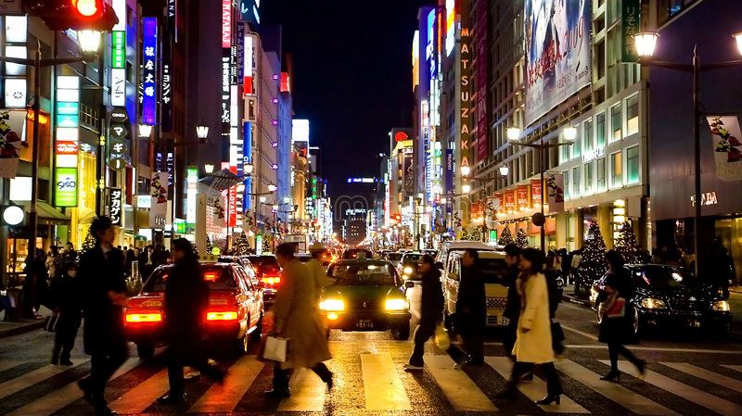

Slide 4

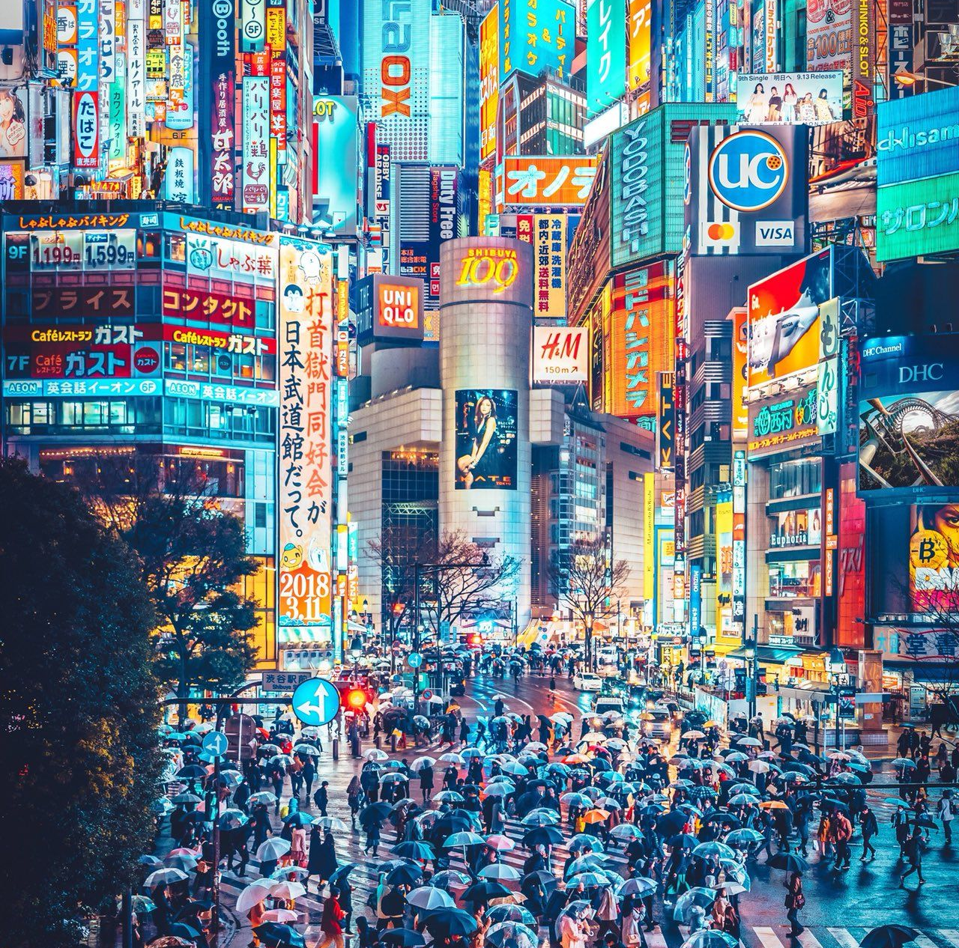
Problem:
During the daytime, especially in the morning and lunch hours, office areas provide huge opportunities for restaurants. Reasonably priced (one lunch meal 8$8$) Shops are usually always full during the lunch hours (11 am -- 2 pm) and, given this scenario, we will go through the benefits and pitfalls of opening a breakfast cum lunch restaurants in highly dense office places. Usually, the profit margin for a decent restaurant lies within 15−20%15−20% range but, it can even go high enough to $35%

Slide 5
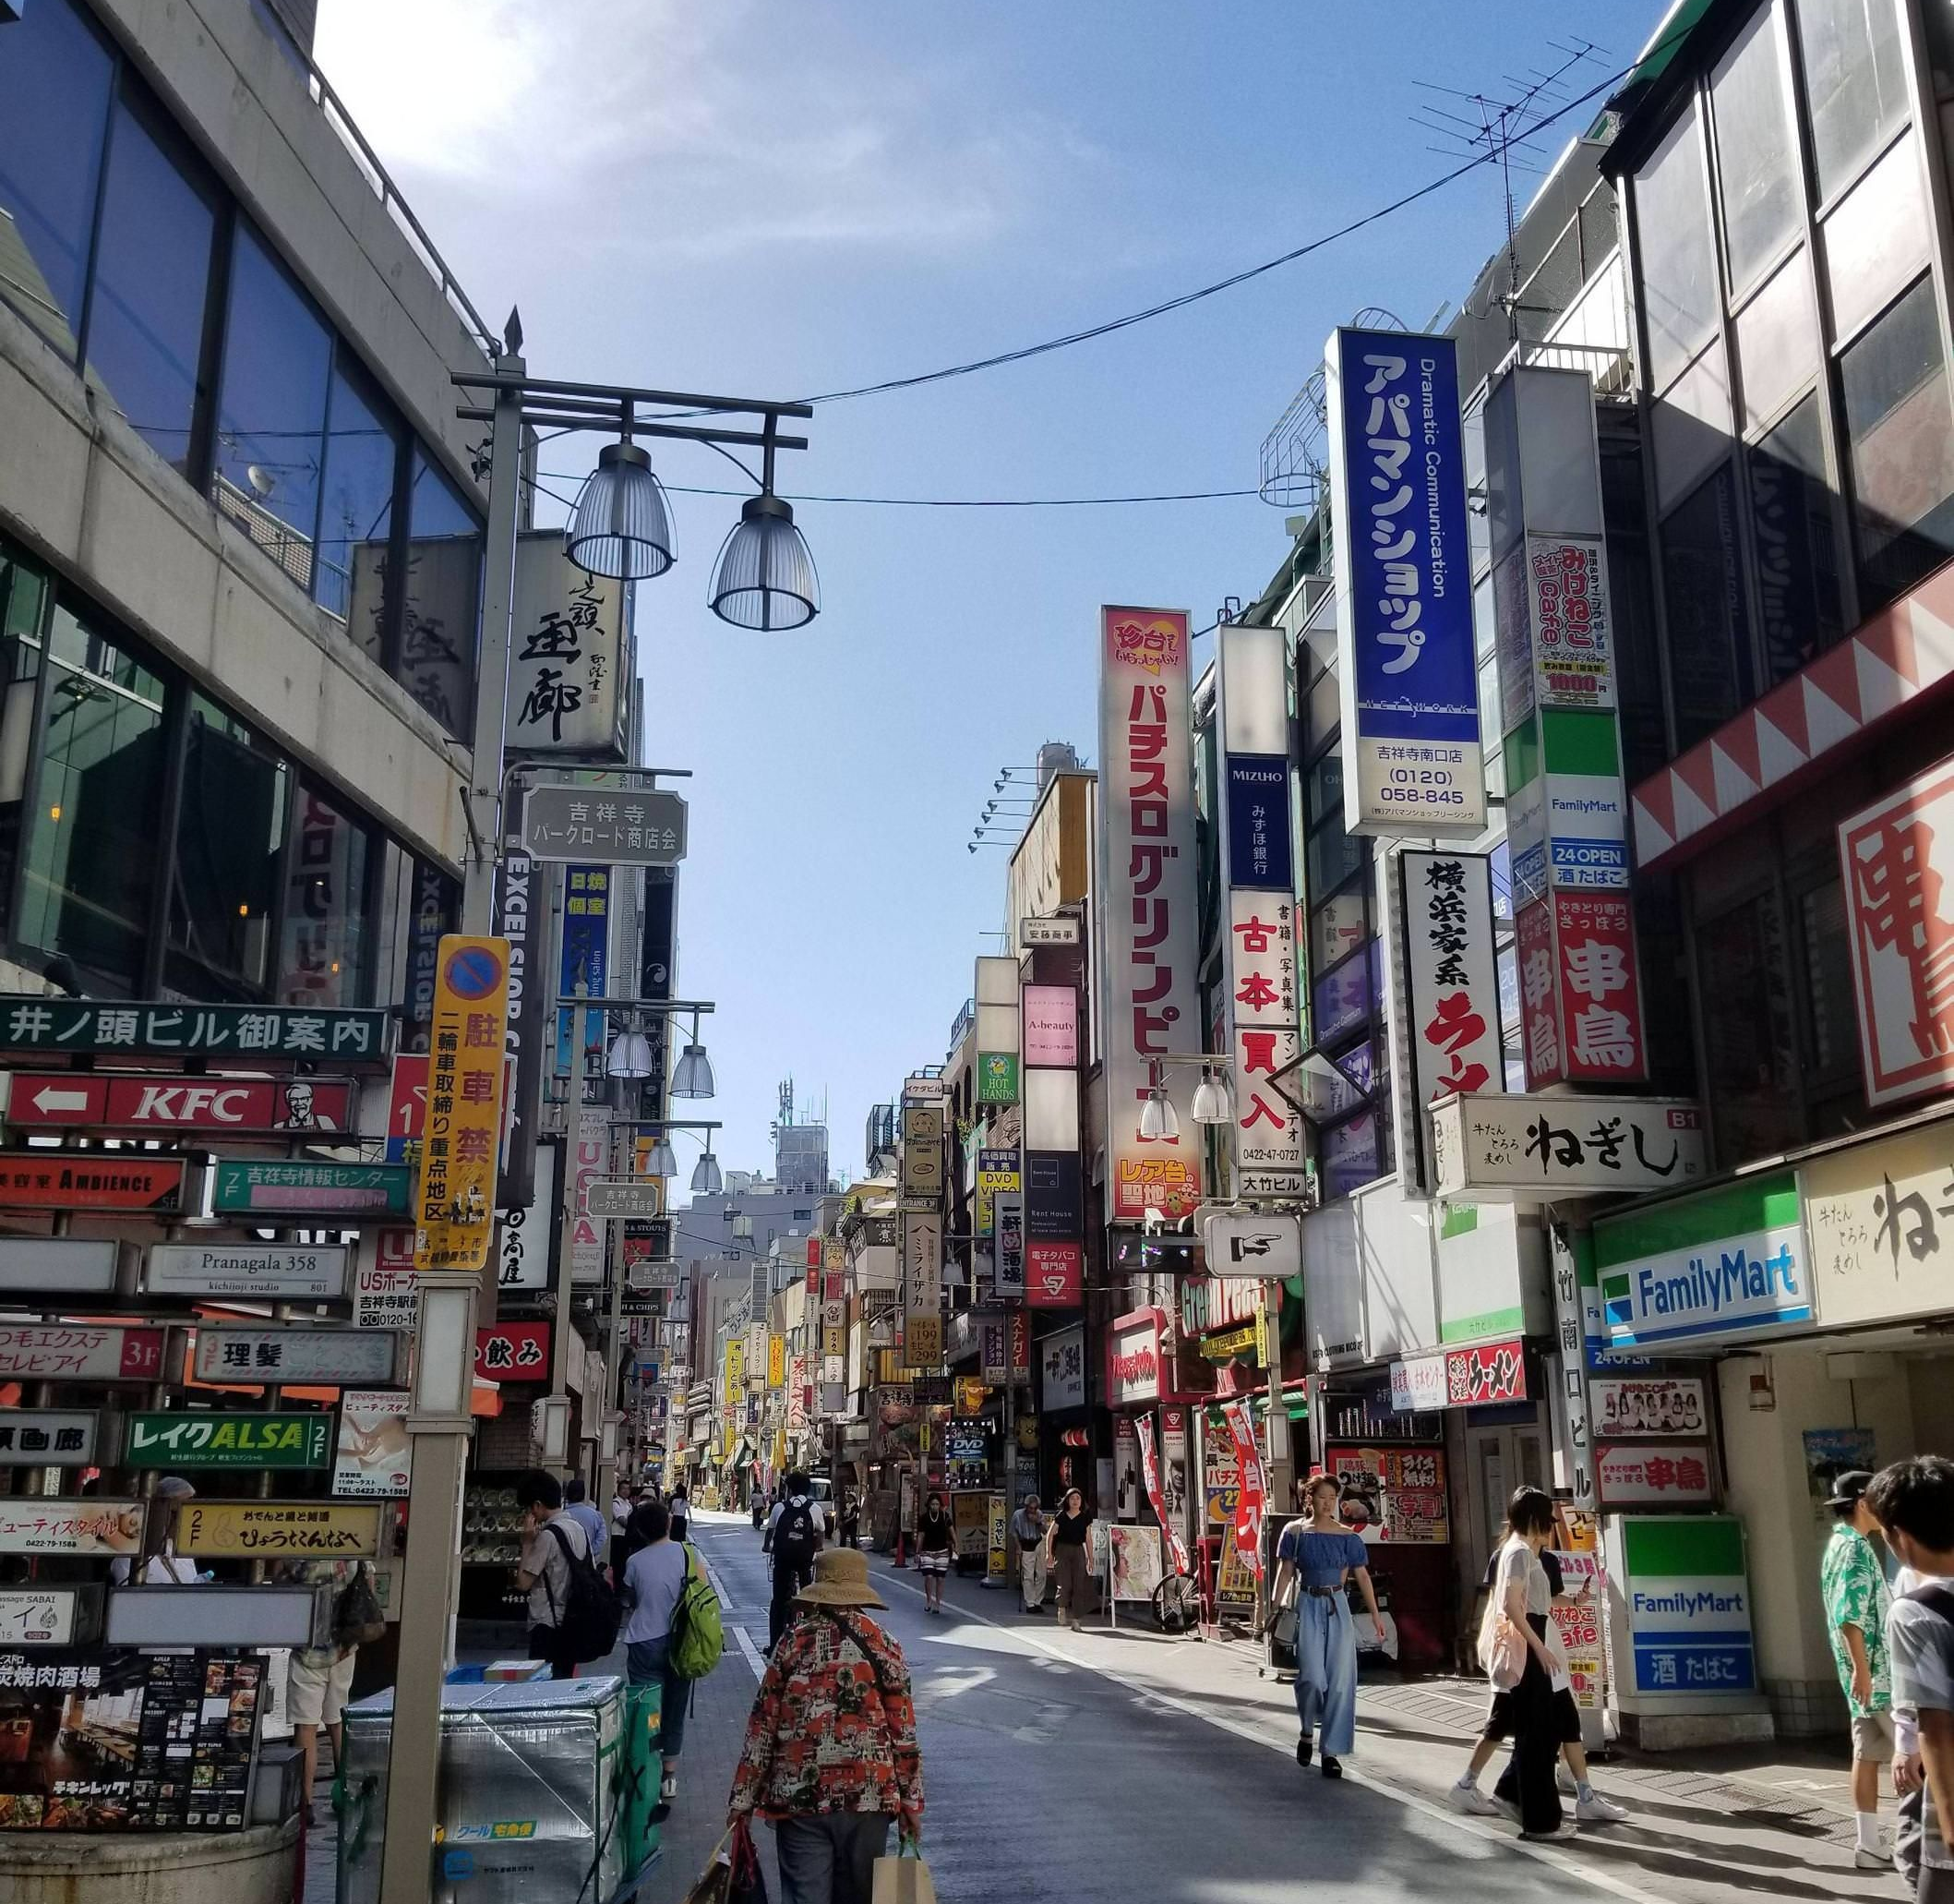
Target Audience:
Business personnel or New startup who wants to invest or open a restaurant in Tokyo.
This analysis will help in guiding them to start or expand restaurants targeting the large pool of office workers, Students and many tourists during lunch hours.

Slide 6
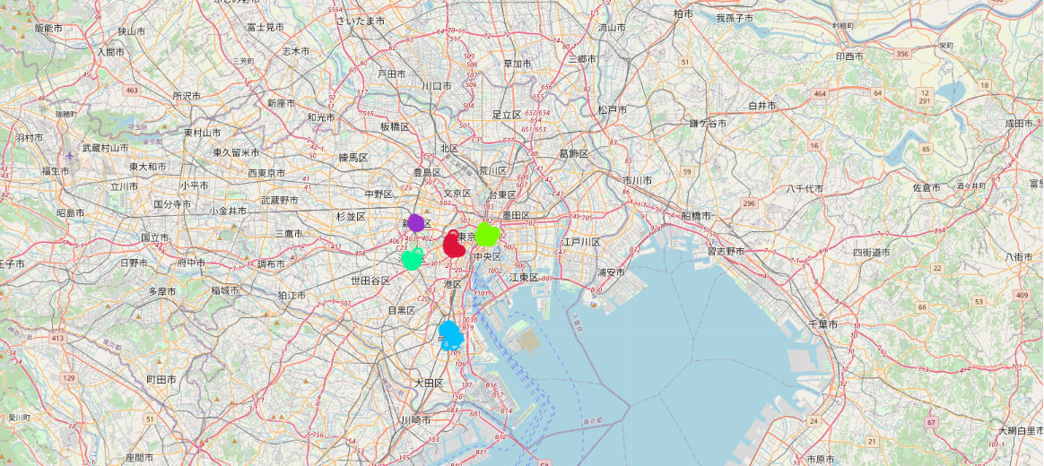
we found BBQ joint restaurants top the charts of common venues in the 5 districts, followed by Japanese restaurants and sake bars.

Slide 7
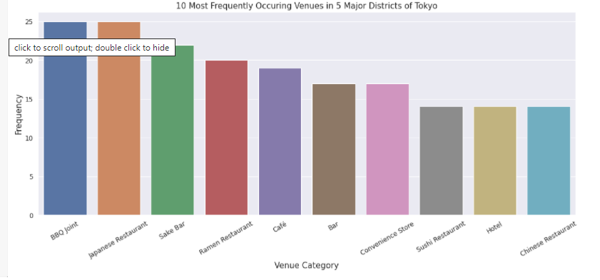
the ten most Frequent Venues in these 5 districts

Slide 8
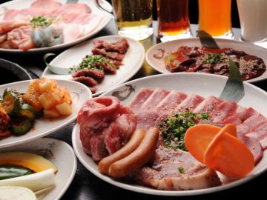
BBQ JOINTS

